Slide 2

Women and the Open Web
22 March 2014 | Palet Express

Slide 3
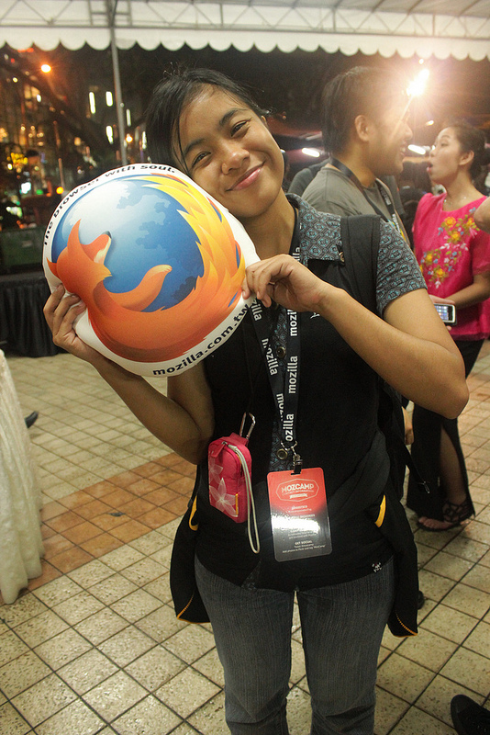
Hi! I’m Faye.
Industrial engineering graduate
Mozilla Rep since 2011
Web enthusiast
Systems and procedures staff in a car manufacturing company
Education and WoMoz Team
#MozillaPH #WoMoz

Slide 4
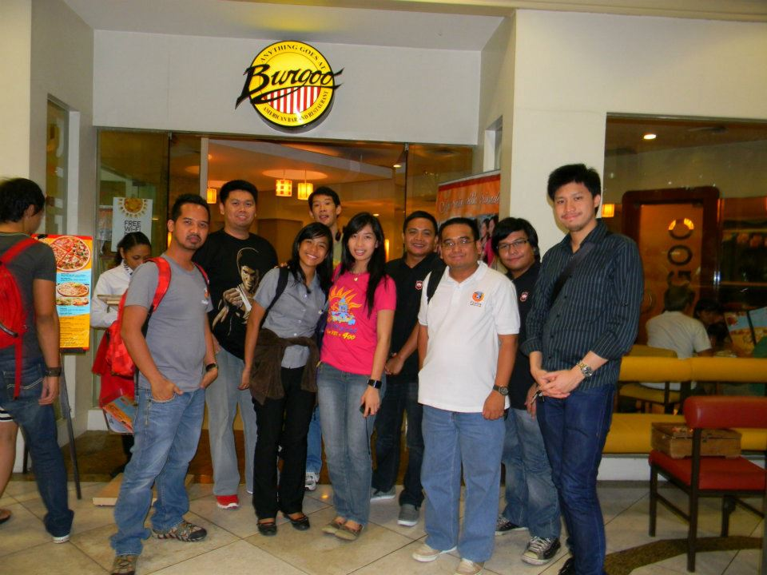
Notes:
This is where I share my experience on being really scared about meeting up with the MozPH team, because they are dominated by men! But then I realized I have nothing to worry about when I actually met them.

Slide 5
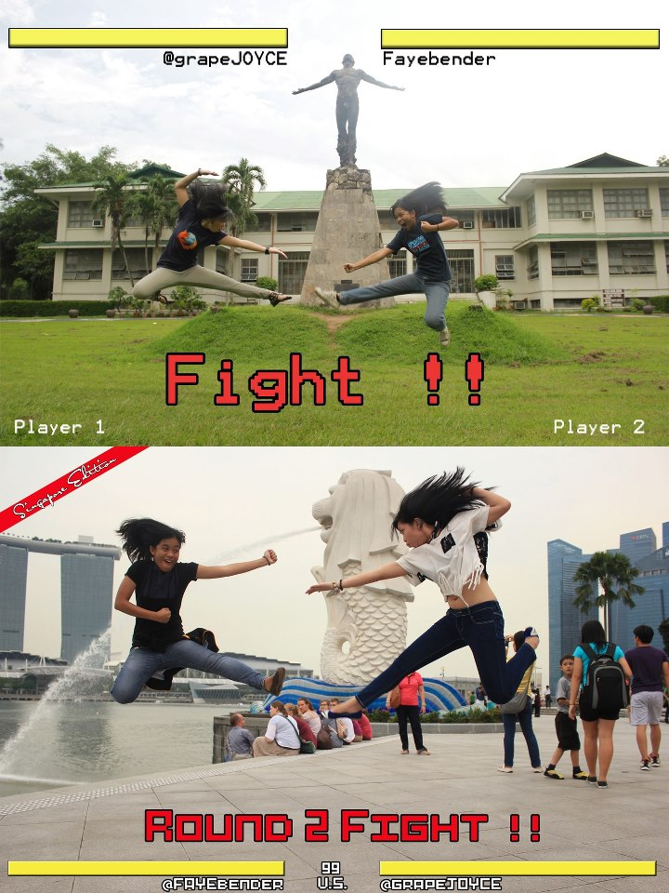
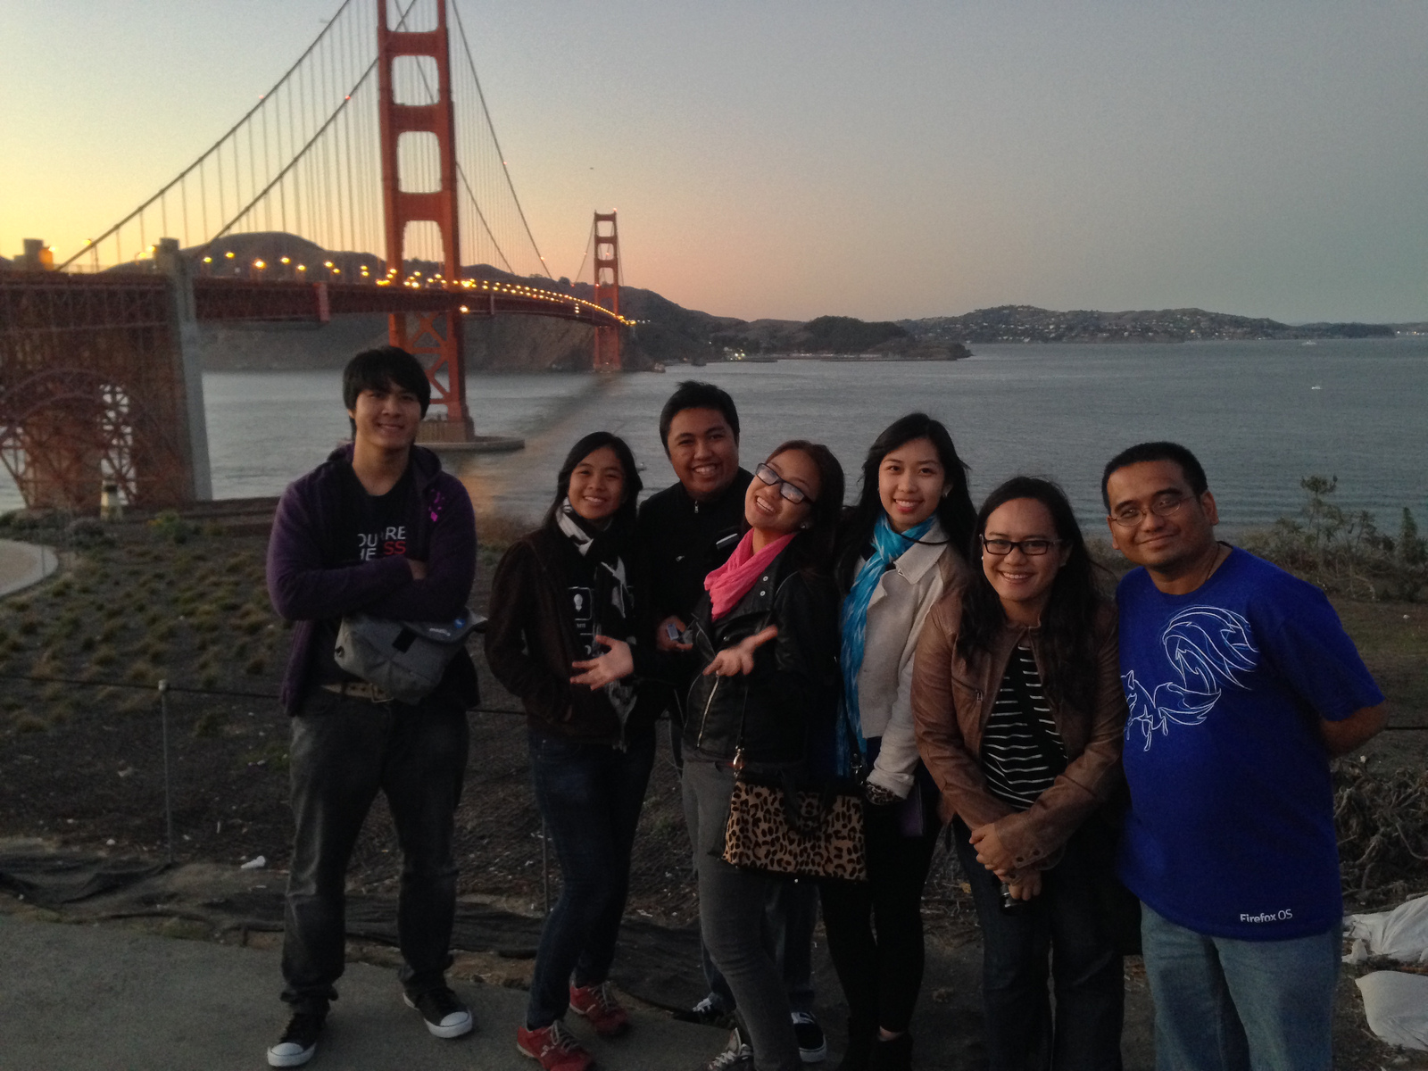
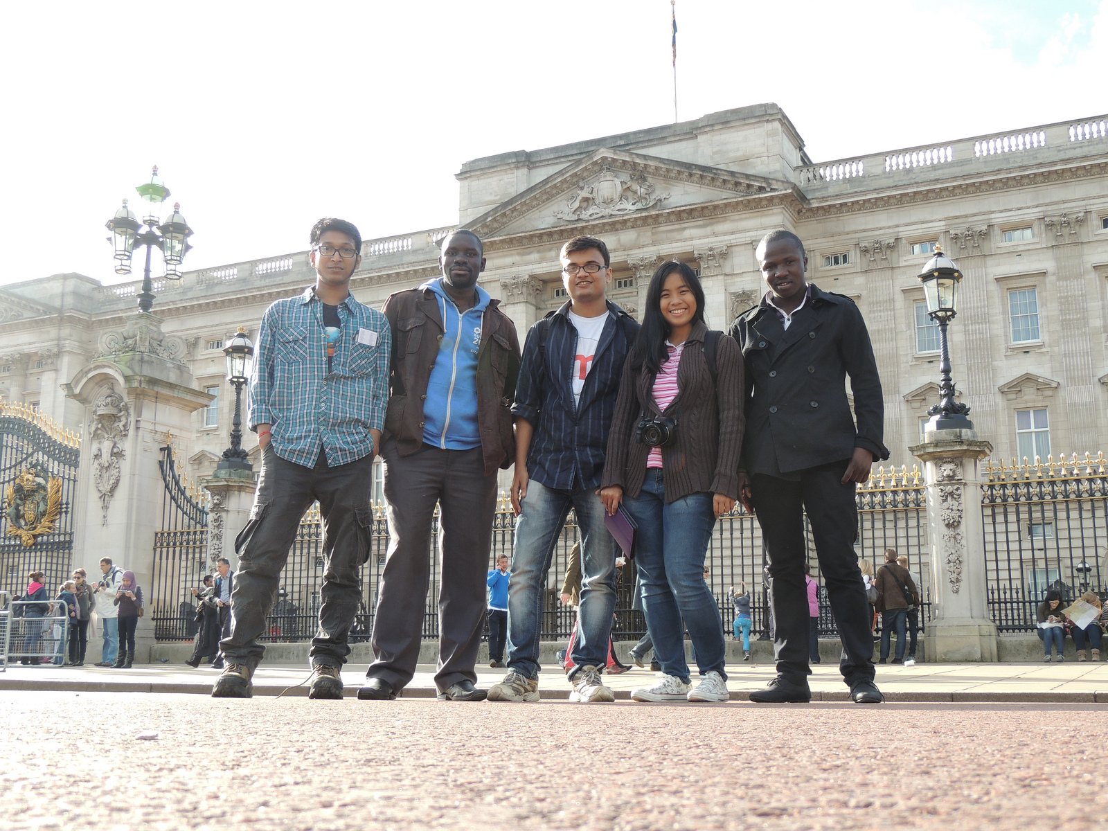
Notes:
This is where I share how I transformed from being a shy, scared girl to a Mozillian who have been to places with our awesome team.

Slide 6
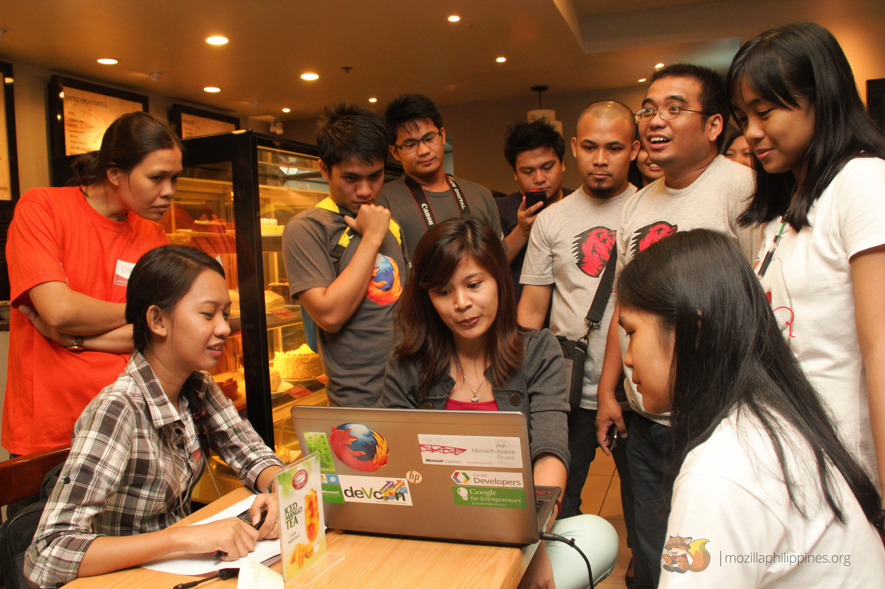
WHERE DO WOMEN COME IN?

Slide 7
Over 50% of humans are women
Half of your potential users are women
….and yet there is a low presence of women in open web initiatives.

Slide 8






Slide 9
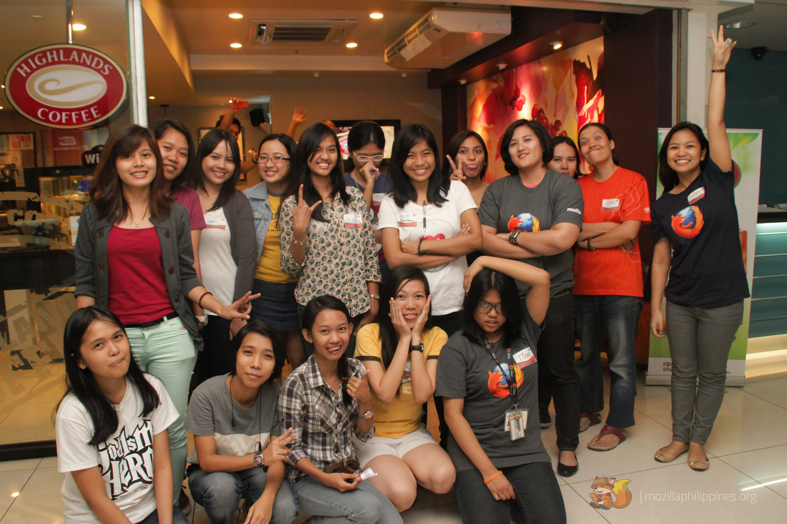
EMPOWERMENT
Notes:
There is a low presence of women in open source projects because we lack empowerment.

Slide 10
Notes:
Those are the main concerns of the Women and Mozilla initiative of Mozilla, one of the projects of open web advocates to empower women in the field of free and open source technologies.

Slide 11
Our goals
Increase gender diversity in Mozilla communities
Improve visibility and involvement of women in open source projects
Empower women in the industry

Slide 12
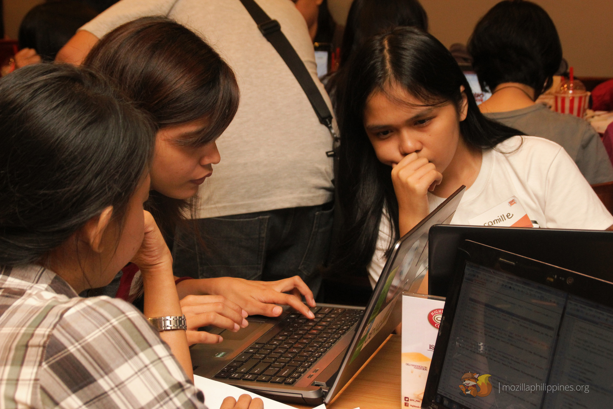
HOW CAN WOMEN CONTRIBUTE?

Slide 13
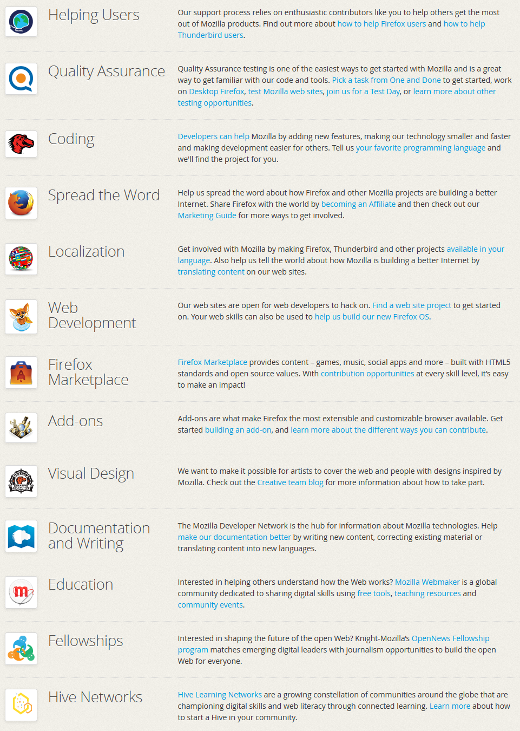


mozilla.org/contribute
Notes:
So in Mozilla, other than the devt of products to drive innovation in the Internet, as a non-profit, we have our community building aspects.. We create projects and programs to keep the web open. We have contribution areas, so yung mga enumerated ditto na areas, for contributors and if you want to level up being a contributor, dun na yung Mozilla Reps.

Slide 14
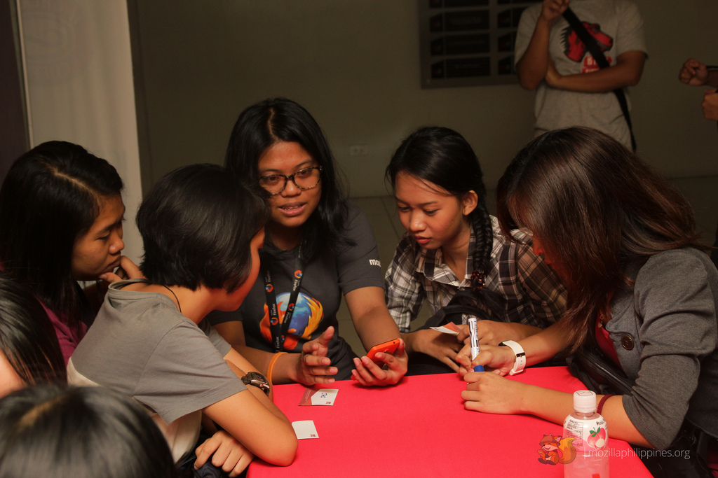
HOW TO GET WOMEN INVOLVED?

Slide 15
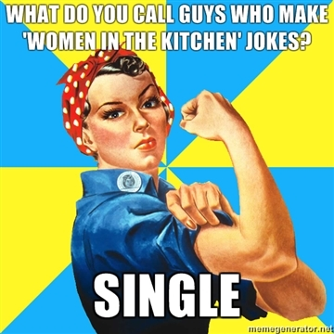
How to get women involved?
No sexist jokes
Make women feel expected on events
Create activities and programs for women

Slide 16
What will we do?
Recruit women the WoMoz initiative in the Philippines
Organize events together!
Improve the online presence of the cause!
Join tech events and promote the cause
Promote Mozilla Reps/Student Ambassadors to women
Introduce volunteer opportunities in Mozilla

Slide 17
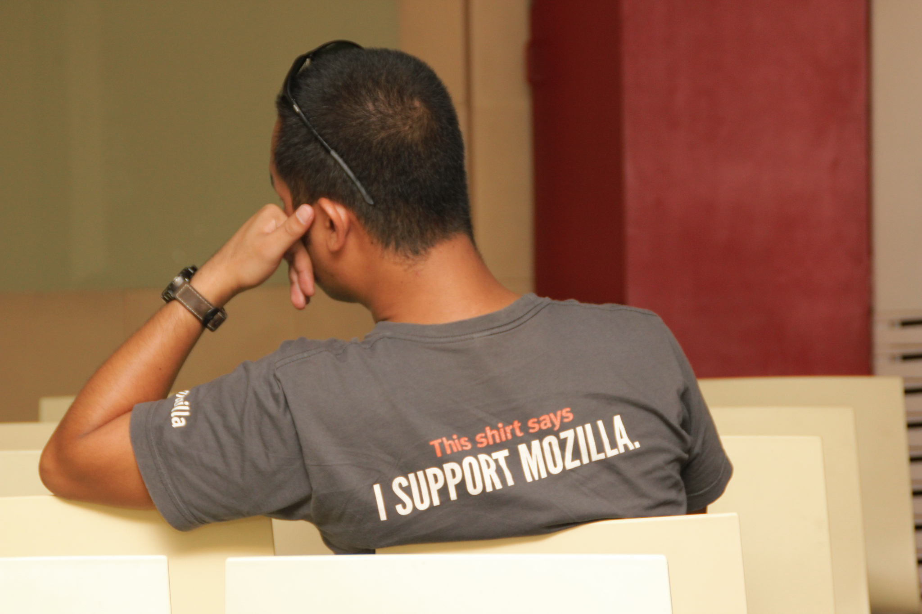
ANYONE CAN JOIN.
Regardless of age, gender, industry, ANYTHING!

Slide 18
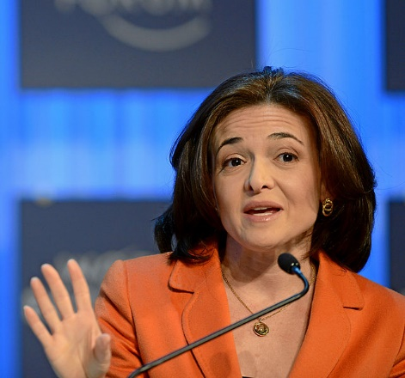
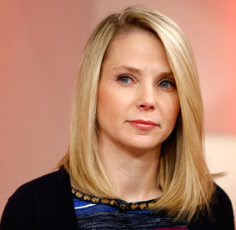
Some Inspiration
Sheryl Sandberg
Chief Operating Officer of Facebook
Marissa Mayer
President & CEO of Yahoo!

Slide 19
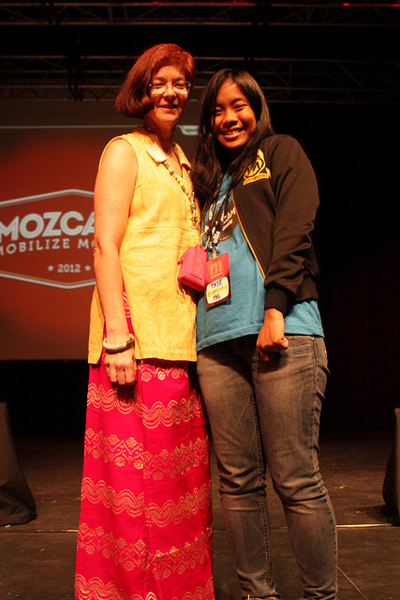
Some inspiration
Mitchell Baker
Mozilla Chief Lizard Wrangler
Chairperson of Mozilla Foundation
Chairperson and former CEO of Mozilla Corporation
Notes:
Inspiration

Slide 20
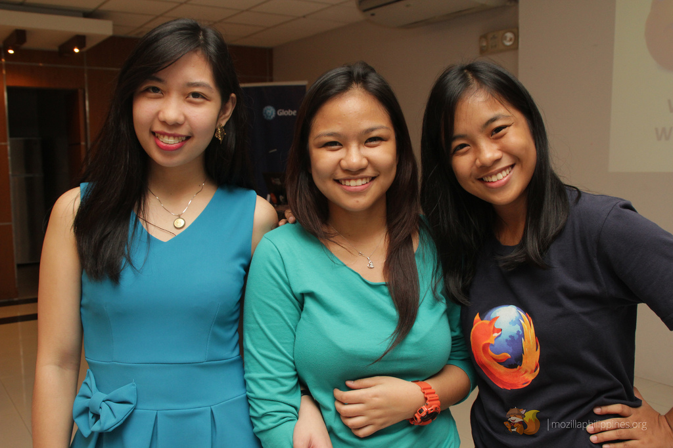
#MozPHGirls

Slide 21
Join the WoMoz initiative
Mailing List (womoz@lists.womoz.org )
Subscribe through http://bit.ly/womozlist
Wiki (https://wiki.mozilla.org/WoMoz)
Twitter (@womozilla)
www.womoz.org

Slide 22



My Contact Details
fayetandog@mozillaph.org
@fayetandog
fb.me/fayetandog

Slide 23
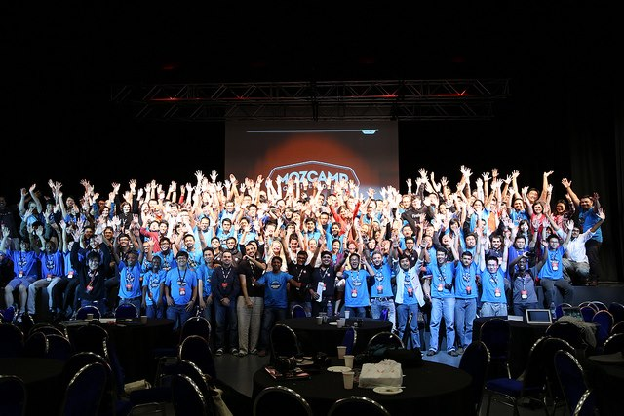
WHO KNOWS WHERE PASSION WILL GET YOU?

